Slide 1
Lab. 07
Logic Design Lab.
Spring 2014
Prof. Naehyuck Chang
(naehyuck@snu.ac.kr)
TA. Taeyoung Kim
(tykim@iris.snu.ac.kr)
TA. Duseok Kang
(kangds0829@iris.snu.ac.kr)
RUBIS

Slide 2
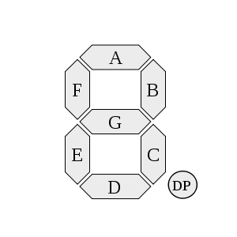
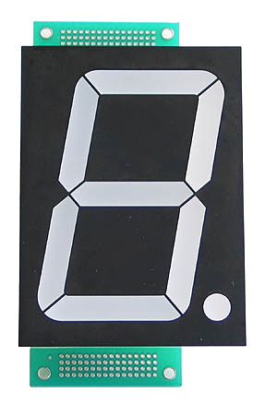

7-Segment Display (1)
7-segment display
A form of electronic display device for displaying decimal numerals that is an alternative to the more complex dot-matrix displays.
Widely used in digital clocks, electronic meters, and other electronic devices for displaying numerical information.
RUBIS

Slide 3
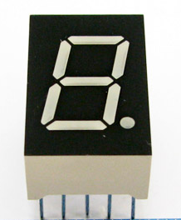
7-Segment Display (2)
G
F
A
B
VCC
or
GND
PIN
E
D
C
DP
7-segment display
RUBIS

Slide 4
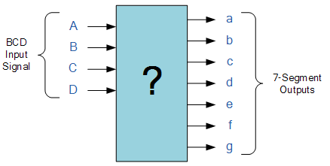
Practice (result report)
Implement BCD to 7-segment decoder on Bread Board according to the Q.2 and Q.3 of preliminary report 6
Write result report (7th) about today’s practice. Maximum 3 pages. (Due : April, 2nd)
RUBIS

Slide 5
Preliminary Report (7th)
Requirements
  Either in Korean or in English
  Maximum 3 pages
  Due : March, 31th
Explain ‘timing waveform for pulse-shaper circuit’
  You can find that figure on the textbook.
Explain multiplexer, de-multiplexer
Check datasheet for 7448, 74150(16:1 mux)
  You can get the datasheet from online.
RUBIS

